Slide 1

Varendra University
Dept. of Computer Science & Engineering (CSE)
Lab 3
Course Title: Microprocessor and Assembly Language Lab
Course No: CSE 3206
Prepared By:
Md. Adnan Sami
Lecturer, Dept. of CSE, VU

Slide 2
Experiment No: 03
Name of the Experiment:
Write an assembly language program to multiply two numbers using EMU8086.
Write an assembly language program to divide two numbers using EMU8086.

Slide 3
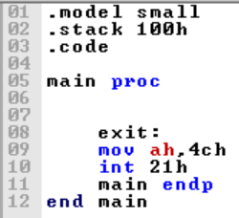
Return

Slide 4
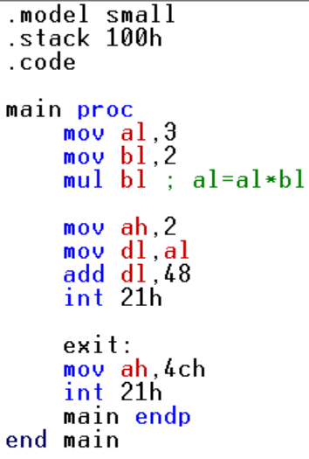
1. Write an assembly language program to multiply two numbers using EMU8086.

Slide 5
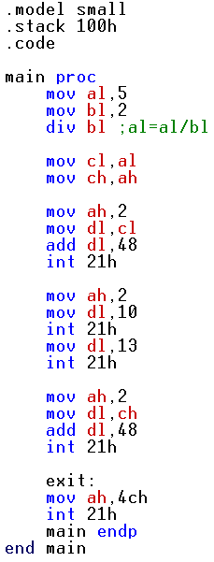
2. Write an assembly language program to divide two numbers using EMU8086.

